Slide 1
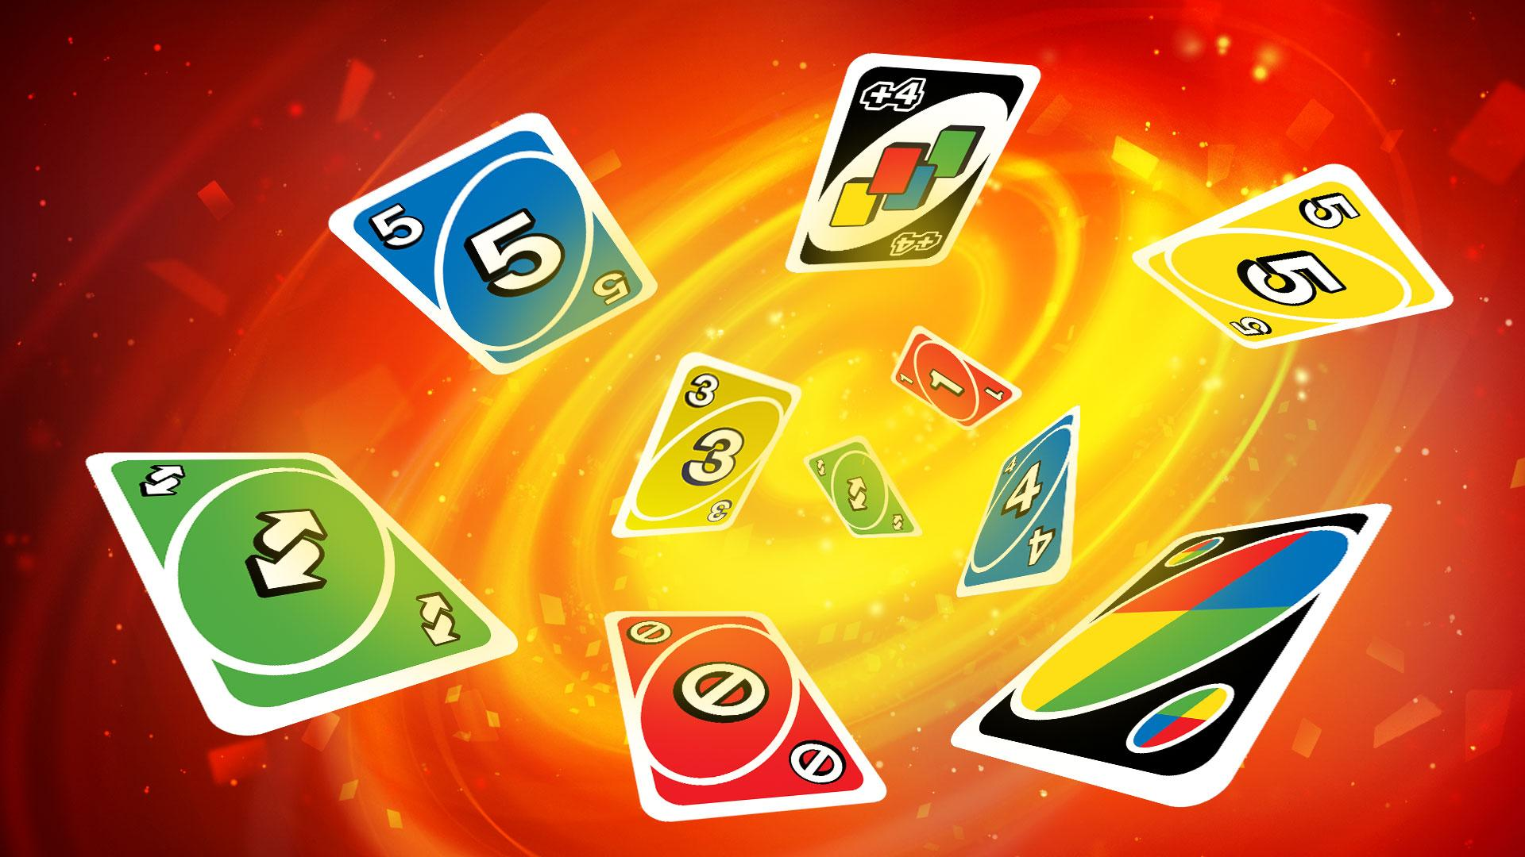
Term Project Game:
Uno
Group members:
Justin Su
Ronald Tieu
Arpaiana Tursunalieva
Victor Uong
Kayla Young

Slide 2

Authentication
Uno
Log In
Username
Password
Create Account

Slide 3


















Account Creation
Create Account
Username
Password
Select Avatar
A
B
C
D
E
F
G
H
I
J
K
L
M
N
O
P
Q
R
S
T

Slide 4
Waiting Lobby
UNO
Create Game
Return to game
Setting??
Rules
Log out
Game Title
Players
Status
List of Players
Participant1’s game
2 / 4
Waiting
participant1
Participant6’s game
2 / 2
Full
participant2
participant3
participant4
participant5
participant6
[participant1] Hello, who wants to play a game?
Enter

Slide 5
Lobby Features
Every account ID logged in will appear on the right side in “list of participants”
The chat feature at the bottom can be seen by all participants.
Upon creation of a game, the host needs to specify the number of players, and the special rules.
A game can only start when the number of required players is met.
If the user has left an on-going game, he can re-join at anytime, provided the game hasn’t finished. The user will return with the same cards as he left.

Slide 6
Rules Page
HOW TO PLAY
Back to Lobby
Log out
Basic Rules
- can only play a cards with same color/number
- picking from deck
- moving order
Special Cards
- skip turn
- +2
- +4
- Reverse order
Winning Condition

Slide 7
Game Board
participant3
Log out
Cards: 8
Cards: 4
Cards: 4
Deck
8
8
5
participant4
participant2
Cards: 8
chat
1
8
8
+4
5
+2
participant1

Slide 8
Game Features
Each player starts with 7 cards in their hands.
The starting order of the game is counter-clockwise
If a player cannot play any cards, they must pick a card from the deck
In the real game, each deck has 3 “customisable cards”, but we will not have those. Thus, there will be a total of 109 cards in the deck. The distribution of cards will be shown in the rule/tutorial pages.
When a player has 2 cards left, and plays a card, a UNO! appears on the screen.
A round is over when a player gets rid of all their cards in their hands.
The score of each card played is tallied up.
The first person to hit 500 points (or customisable) after any round, wins the game of Uno.

Slide 9
Game Features
Game Mechanics:
Ability to pick up and play cards, match colors, symbols and numbers on the card pile
Ability to use special action cards (Reverse, Draw, Wild, Skip)
Gameplay:
Objective is to be the first player to get rid of cards and win
Implement logic that recognizes when player has one card left and asks them to call “UNO”, failure to do so will make player draw two cards
Player should get notified when opponent plays special action card
Scoring:
Implement a scoring system that calculates scores based on how many cards left in players hands?

Slide 10
Game Features
Game Settings:
Implement logic that lets player choose the difficulty of the game? (easy/hard)
Implement feature that lets player adjust in-game sounds and music
Implement logic that allows player to customize their avatars and in game names
Implement feature that lets player customize their cards and change background pic?
User should be able to create and login to the account
Save:
Implement feature that saves the current status of the game automatically? Or should it be provided as an option for player in settings?
Chat:
Player should be able to chat with other players during the game
Player should be able to send friend requests to other players?

Slide 11
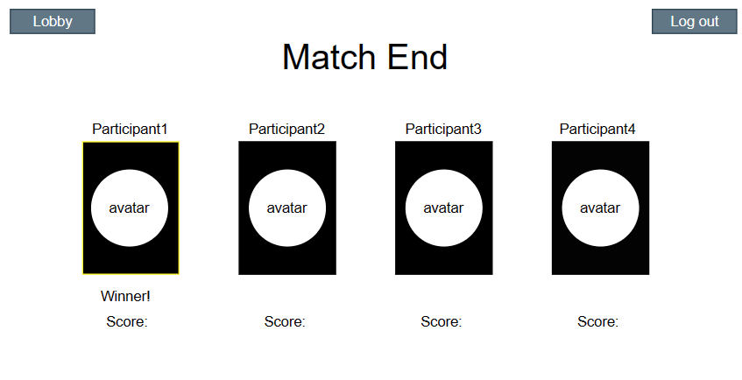
Match End

Slide 12
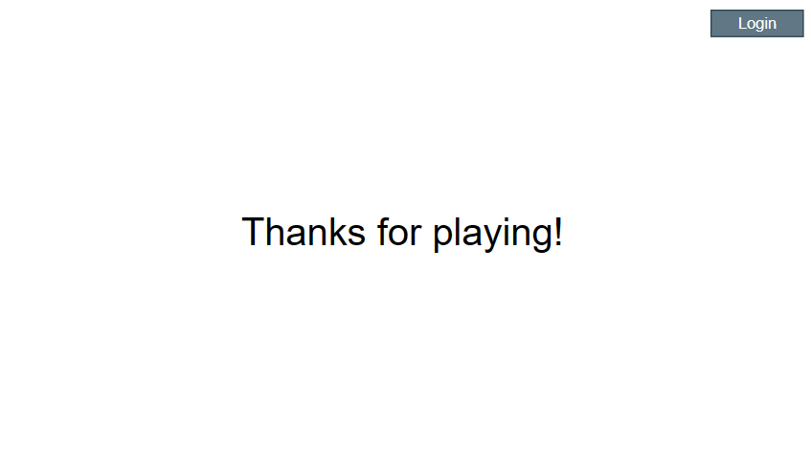
Logout/Thanks for playing

